Slide 1
DIGITAL MARKETING PROJECT PHASE 2
TEAM ID :- LTVIP2023TMID10345
TEAM LEAD: DOLA.SNEHITHA
MEMBERS: GALLA.RAMYA
GODDU.INDIRAMMA
LOTTI.PAVANI
NASARI.BHARGAVI

Slide 2
PART 1:- BRAND STUDY , COMPETITOR ANALYSIS & BUYER’S/AUDIENCE’S PERSONA

Slide 3
RESEARCH BRAND : AMUL
Amul is one of the most successful and popular brands in India, with a wide range of dairy products that cater to the diverse tastes and preferences of its customers. Amul has a brand value of $5 billion as of 2016 and a turnover of Rs 53,000 crore in 2020. Amul aims to achieve Rs 1 lakh crore in sales by 2025.Amul's marketing strategies are based on its branding as 'The Taste of India', its product portfolio, its low-cost pricing strategy, its advertising campaigns, and its digital marketing strategy. Amul's marketing mix consists of four Ps: product, price, place, and promotion.. Amul also leverages its iconic mascot, the Amul Girl, who features in witty and topical advertisements that capture the attention and interest of the audience. Amul also uses social media platforms, such as Facebook, Twitter, YouTube, and Instagram, to engage with its customers and promote its products.

Slide 4
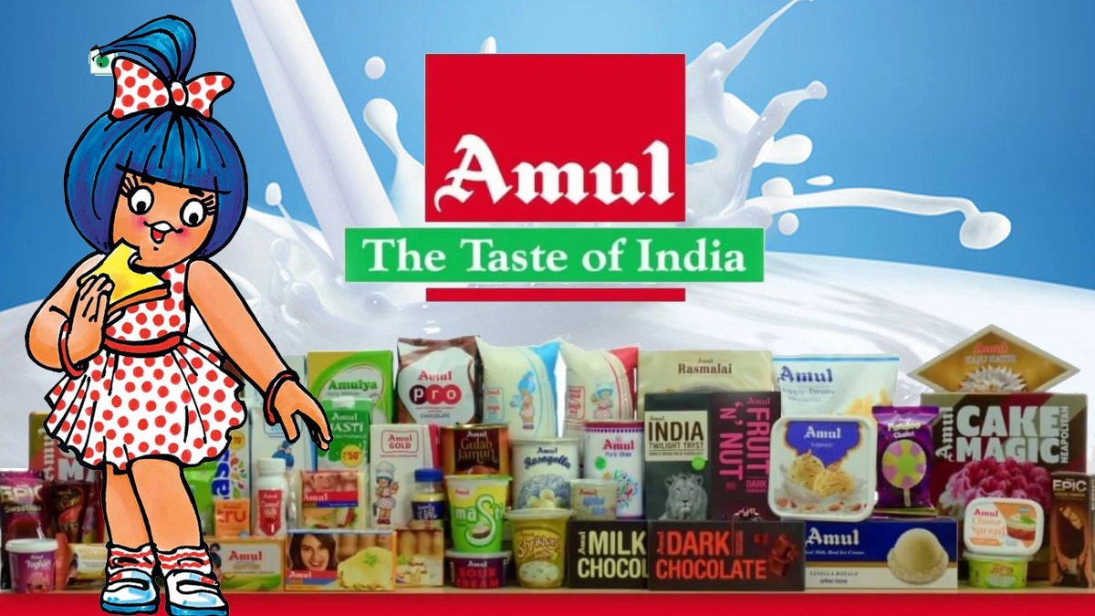

Slide 5
MISSION/VALUES OF AMUL:
Amul is a dairy cooperative that was founded in 1946 by the farmers of Kaira district in Gujarat, India.
Its mission is to provide a fair remuneration to the farmers and also serve the interest of consumers by providing quality products that are good value for money.
Some of the values that Amul follows are:-
Cooperative spirit: Amul is owned and managed by the farmers themselves, who have a stake in its success and growth. Amul believes in the power of collective action and mutual benefit.
Innovation: Amul is constantly innovating its products, processes, and marketing strategies to meet the changing needs and expectations of its customers.
Quality: Amul is committed to maintaining high standards of quality and hygiene in its production and distribution.
Customer satisfaction: Amul strives to delight its customers by offering them a variety of choices, convenience, and affordability. Amul listens to the feedback and suggestions of its customers and tries to improve its products and services accordingly.

Slide 6
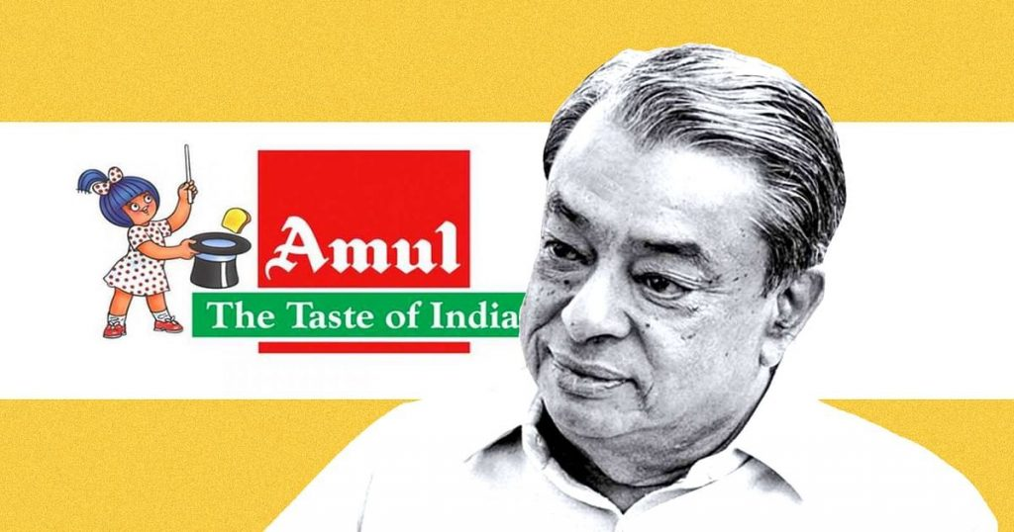
FONDER OF AMUL INDIA: Dr.Verghese Kurien

Slide 7
USP OF AMUL:
The main USP of Amul is its low pricing and high quality of dairy products. Amul is a cooperative of millions of milk producers who ensure a steady supply of fresh and pure milk. Amul also has a strong distribution network that reaches every corner of India. Amul offers a wide range of products such as milk, butter, cheese, ghee, ice cream, yogurt, chocolate, and more. Amul is also known for its innovative marketing campaigns that feature the iconic Amul girl and catchy slogans. Amul is a trusted brand that has been serving the nation for over seven decades.

Slide 8
BRAND TONE AND IDENTY OF AMUL:
Brand Identity : Amul is a brand that has a strong brand identity. Its iconic brand identity is the Amul girl, which was created by Eustace Fernandes in 1966. Amul has resisted the temptation of creating multiple brands, which has ensured master brand equity leverage as well as a multiplier effect at lower advertising spends. Its positioning as the “Taste of India” gives it the essence of everything that stands for milky goodness made in India .
Brand tone :Amul's brand tone is humorous, witty, and topical. Amul's advertisements, which are often based on current affairs and social issues, have been a hit among consumers and have helped the brand gain a loyal customer base. Amul's ads reflect the pulse of the nation and comment on touchy subjects without offending anybody.
The Amul girl is the mascot of the brand and adds a pinch of humor to every ad. Amul's brand identity and tone have evolved with India over the years. Amul has been keenly using the cartoon figure in its longest-running advertisement campaign, which has earned a Guinness World Record for the longest-running advertisement campaign in the world⁴.
Amul has also embraced digital marketing and has a strong presence on various online platforms such as Facebook, Twitter, YouTube, and Instagram³. Amul's brand identity and tone have remained consistent and relevant to the changing times and tastes of India.

Slide 9
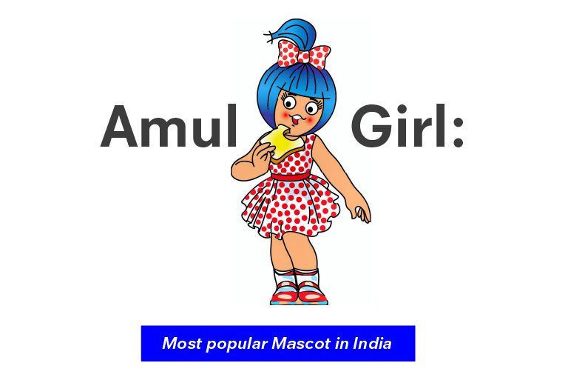
AMUL GIRL:

Slide 10
5 SMART GOALS AND KPIs OF AMUL:
GOALS&KPIs:
Goal-1: Increase the market share of Amul butter in India by 10% in the next year.
KPI-1: Monthly sales volume of Amul butter in different regions and channels.
KPI-2: Monthly market share of Amul butter compared to competitors.
Goal-2: Improve the customer satisfaction and loyalty of Amul products by 15% in the next six months.
KPI-1: Monthly customer satisfaction survey results and Net Promoter Score (NPS) of Amul products.
KPI-2: Monthly customer retention and churn rate of Amul products.
Goal-3: Enhance the brand awareness and reputation of Amul as a socially responsible and environmentally friendly company by 20% in the next year.
KPI-1: Monthly media coverage and social media mentions of Amul's corporate social responsibility (CSR) initiatives and achievements.
KPI-2: Monthly carbon footprint and waste reduction of Amul's operations and supply chain.

Slide 11
Goal-4: Expand the international presence and export of Amul products by 25% in the next two years.
KPI-1: Monthly export volume and revenue of Amul products to different countries and regions.
KPI-2: Monthly market penetration and growth rate of Amul products in different countries and regions.
Goal-5: Innovate and launch new products that cater to the changing needs and preferences of customers by 30% in the next three years.
KPI-1: Monthly research and development (R&D) expenditure and output of Amul's innovation team.
KPI-2: Monthly new product launch and performance of Amul's product portfolio.

Slide 12
BUYER’S/AUDIENCE’S PERSONA: Target Audiences of Amul
Demographics: Amul targets consumers from all age groups, from the toddlers to late 70s, and all income groups⁵. Amul caters to both urban and rural markets, with a presence in over 3,000 towns across India³. Amul also exports its products to various countries, such as the USA, UK, Australia, Canada, Singapore, UAE, and more.
Age: 25-45 years old
Gender: Male or Female
Location: Urban and semi-urban areas in India
Income: Middle to upper-middle class
Psychographics: Amul appeals to consumers who value quality, taste, health, and affordability in their dairy products. Amul also connects with consumers who are patriotic, family-oriented, and socially conscious. Amul's tagline "The Taste of India" reflects its pride in being an Indian brand that represents the diversity and richness of the country's culture and cuisine. Amul also supports the welfare of farmers and rural development through its cooperative model.

Slide 13
Health-Conscious Homemaker
Values health and wellness as a top priority.
Seeks natural and nutritious food options.
Enjoys cooking and experimenting with recipes.
Cares about sustainability and ethical food production.
Appreciates traditional and time-tested brands like Amul.
Behaviour and Interests: Amul targets consumers who have a regular consumption of dairy products, such as milk, butter, cheese, ice cream, etc. Amul also attracts consumers who are interested in trying new and innovative products, such as probiotic drinks, sugar-free ice creams, chocolate pizzas, etc. Amul also engages consumers who are interested in current affairs, social issues, and popular culture through its witty and humorous advertisements featuring the iconic Amul girl.
Age: 25-45 years old.
Gender: Both male and female.
Location: Urban and semi-urban areas in India.
Occupation: Diverse, including professionals, homemakers, and students
.

Slide 14
COMPETITOR ANALYSIS:
THREE COMPETITORS OF AMUL:
Competitor 1: MOTHER DAIRY
USP : Mother Dairy: A company that manufactures and sells milk, milk products, and other edible products. It is a subsidiary of the National Dairy Development Board (NDDB) and has a market share of about 30% in the packaged milk segment. It is also known for its quality and affordable price.
Competitor 2: NESTLE
USP : Nestle: The largest publicly held food company in the world. Nestle offers a wide range of dairy products, confectioneries, pharmaceuticals, beverages, etc. It has popular brands like Maggi, Nescafe, Kit Kat, etc. It has a strong R&D network facilitating continuous innovation.
Competitor 3: BRITANNIA
USP : Britannia: India’s leading manufacturer of high-quality and healthy biscuits, baked goods and dairy products. Britannia has a wide range of bakery products like biscuits, rusks, cakes and dairy products like milk, butter, cheese, etc. It has a strong distribution network ensuring proper availability of the products even in the remotest of areas. It is one of India’s most trusted brands with strong brand recall.

Slide 15
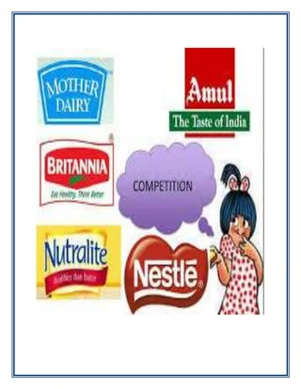

Slide 16
Competitors | USP(unique selling proporstion) | Online communication | Swot analysis
Mother dairy | Mother Dairy is known for its fresh and high-quality dairy products, sourced directly from farmers. They emphasize local production and supply chain integrity. | Mother Dairy uses social media platforms, especially focusing on local markets, and their website to communicate product freshness and farm-to-table approach. | Strengths: Strong focus on freshness, direct sourcing from farmers, strong local presence. Weaknesses: Limited international presence, dependency on specific regions. Opportunities: Growing demand for organic and fresh products, expansion into new regions. Threats: Intense competition, price wars, supply chain disruptions.
Britannia | Britannia is known for its diverse range of bakery products, including biscuits, cakes, and dairy items. They emphasize innovation, taste, and quality in their products. | Britannia actively engages customers through social media platforms, highlighting their products' taste, variety, and health benefits. They also maintain an informative and user-friendly website for product details and online purchases. | Strengths: Diverse product portfolio, strong brand reputation, continuous innovation in products. Weaknesses: Dependency on specific product categories, vulnerability to changing consumer preferences. Opportunities: Growing health-conscious market, expansion into new product categories, increasing online sales. Threats: Intense competition, price fluctuations in raw materials, changing regulations in the food industry.
Nestle | Nestlé is known for its extensive product line, global presence, and focus on nutrition, health, and wellness. | Nestlé utilizes social media platforms, official website, and various online campaigns to engage customers. They often focus on sustainability and community initiatives. | Strengths: Strong brand recognition, diverse product portfolio, global presence. Weaknesses: Controversies related to water usage, occasional product recalls. Opportunities: Growing health and wellness trend, emerging markets. Threats: Intense competition, changing consumer preferences

Slide 17
PART 2:- SEO & KEYWORD RESEARCHPART 2:- SEO & KEYWORD RESEARCH

Slide 18
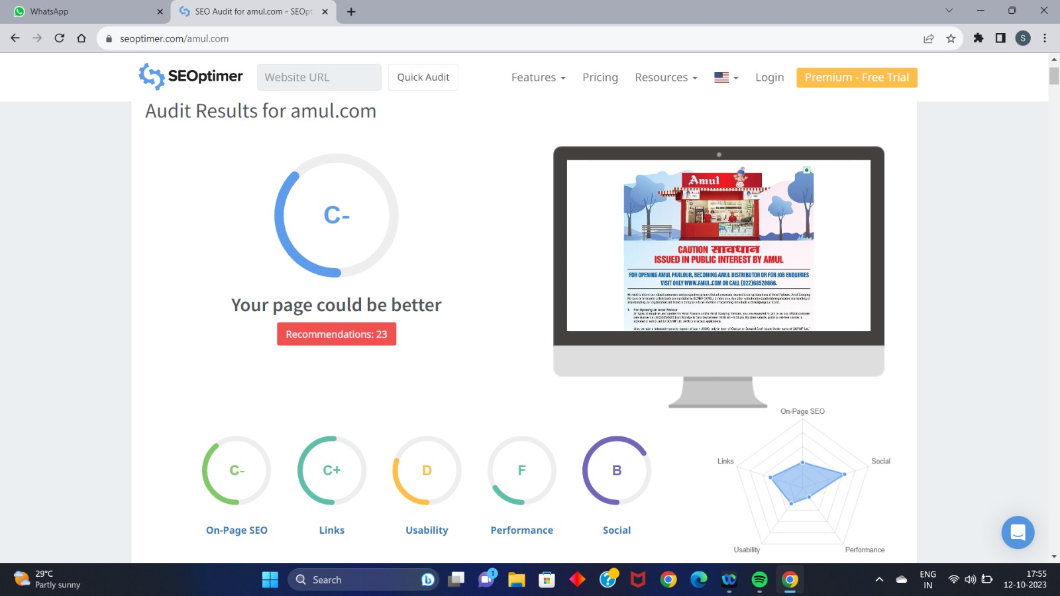
SEO AUDIT REPORT OF AMUL WEBSITE:

Slide 19
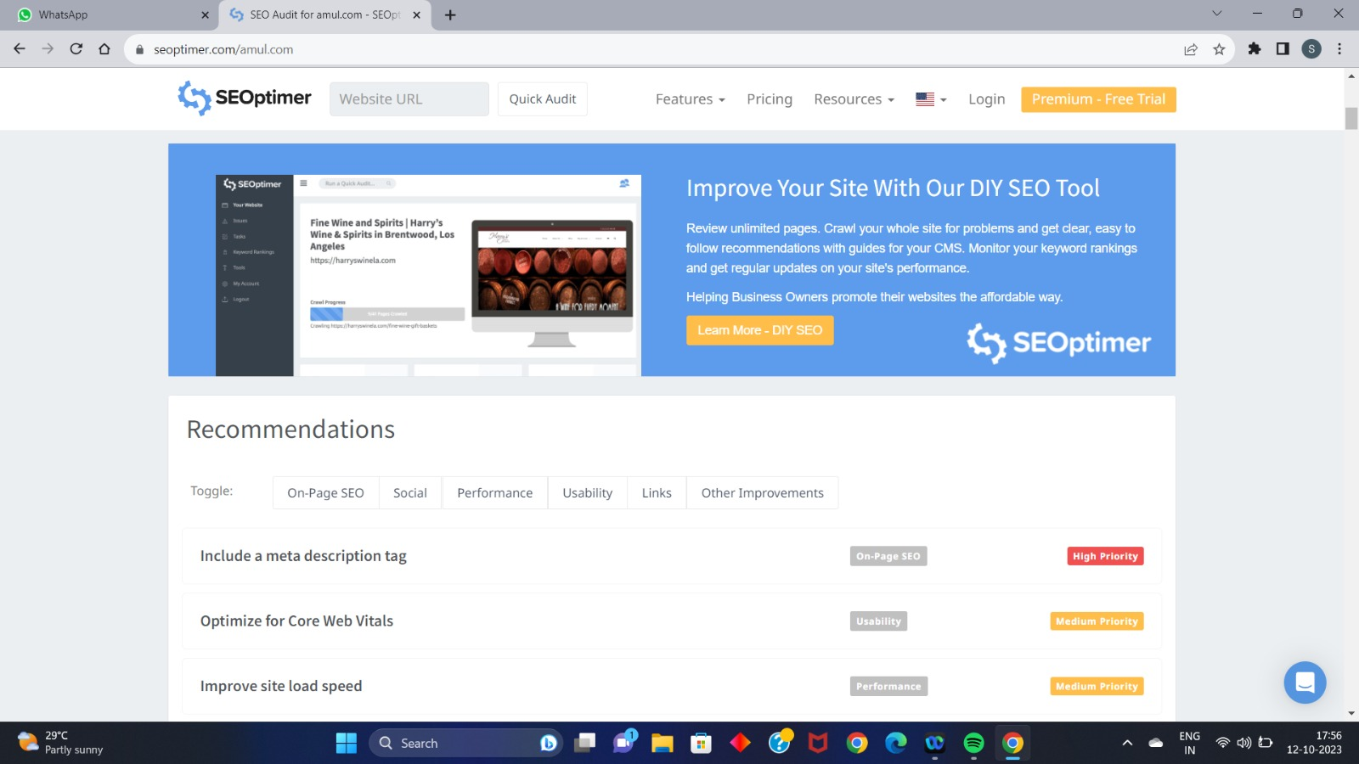
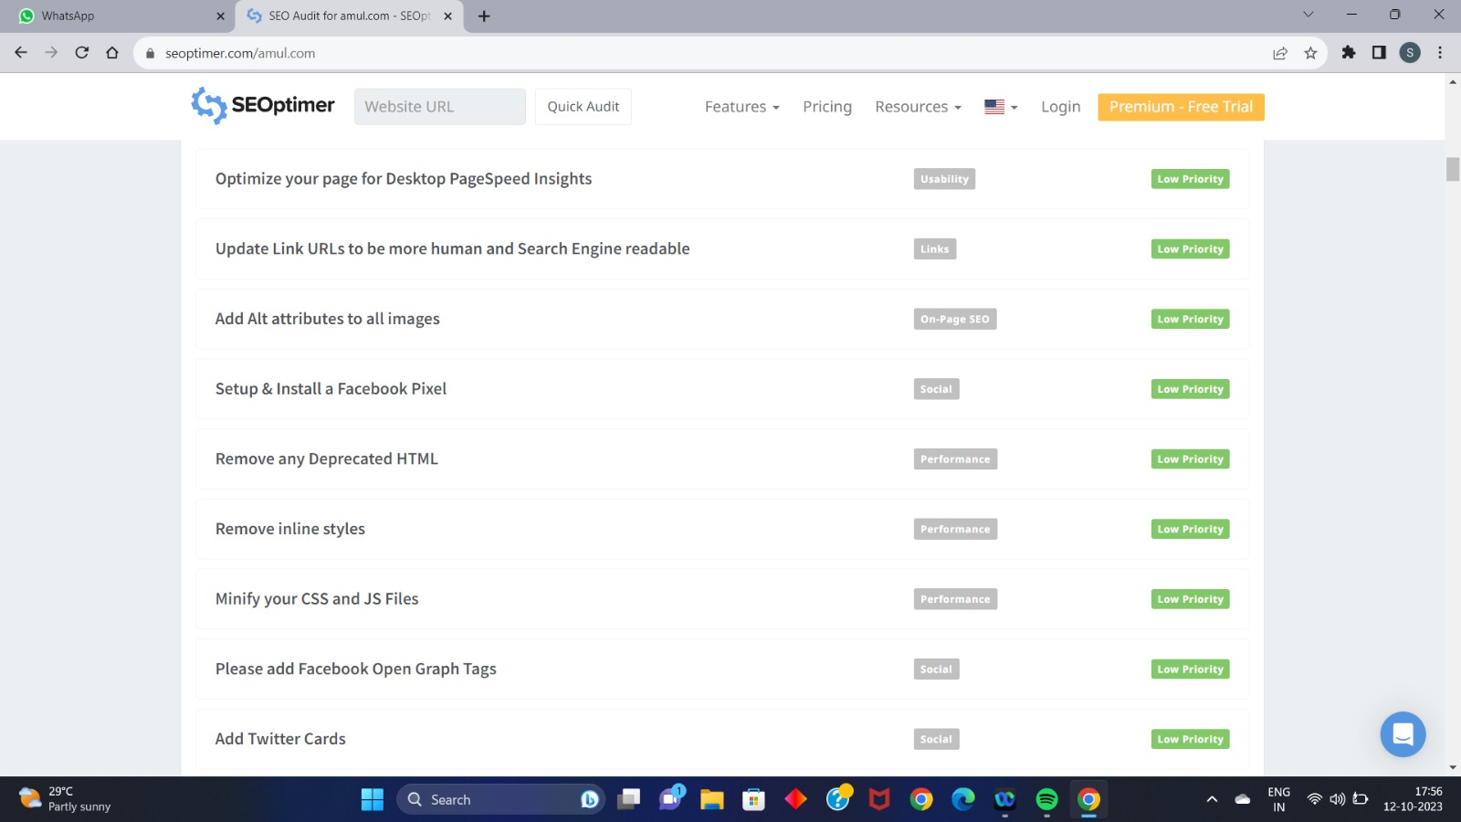

Slide 20
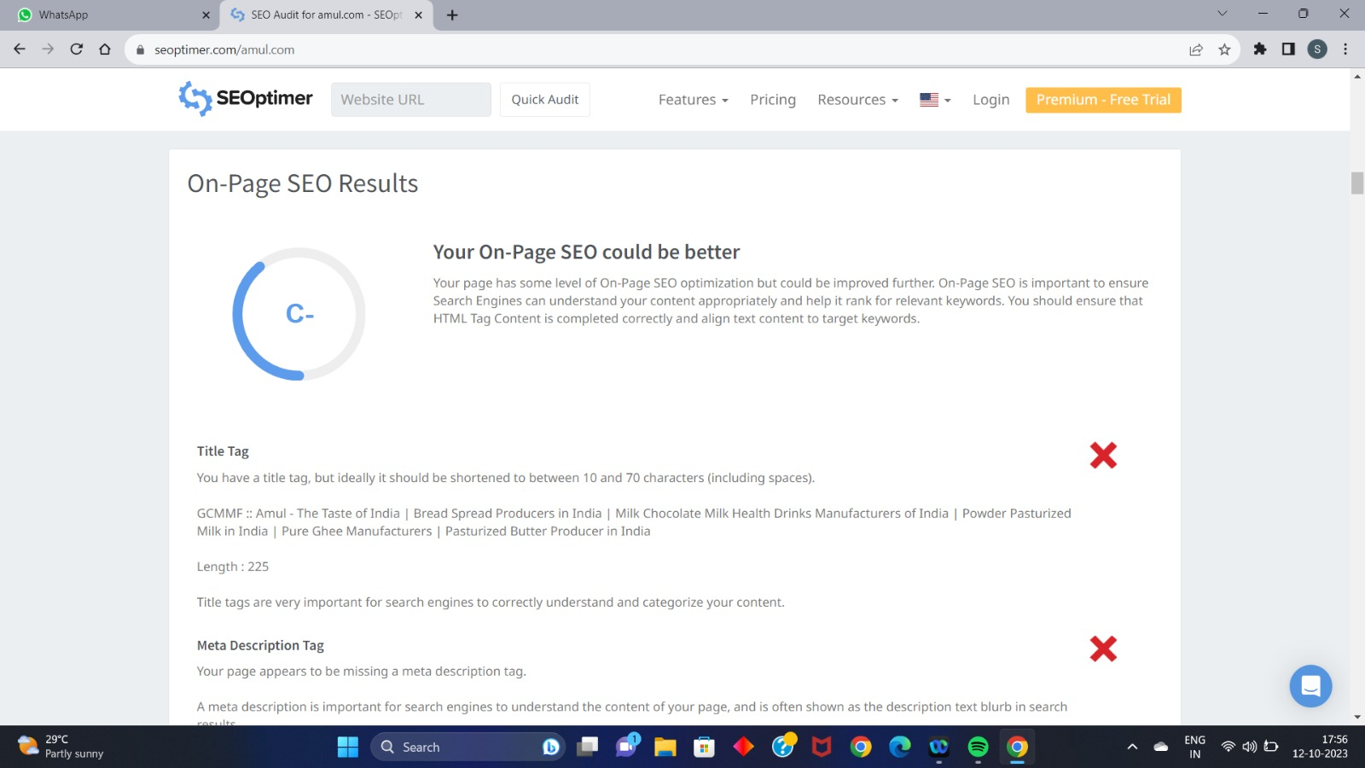
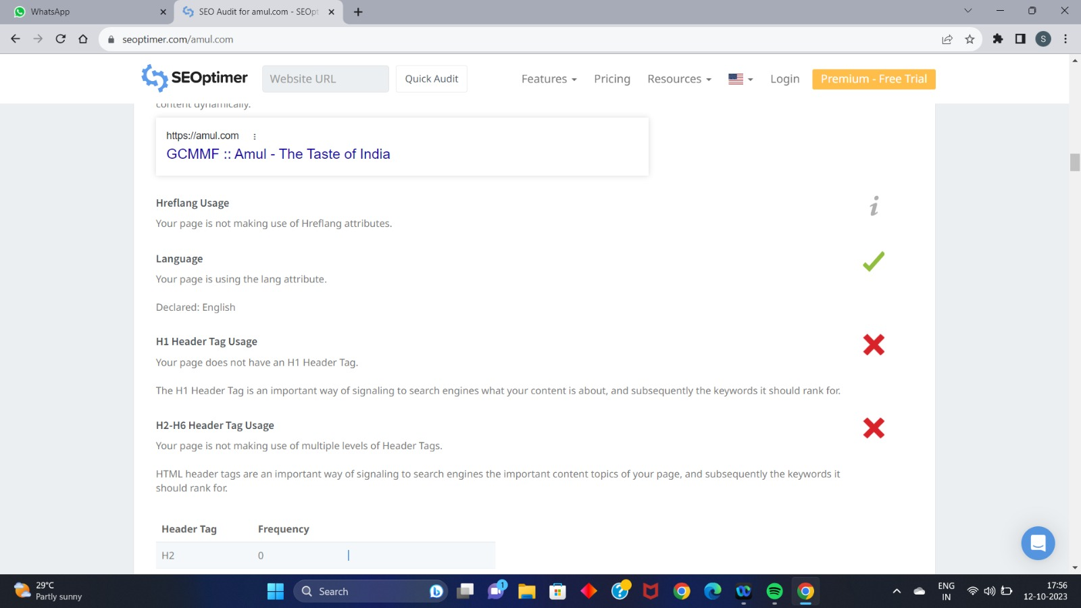

Slide 21
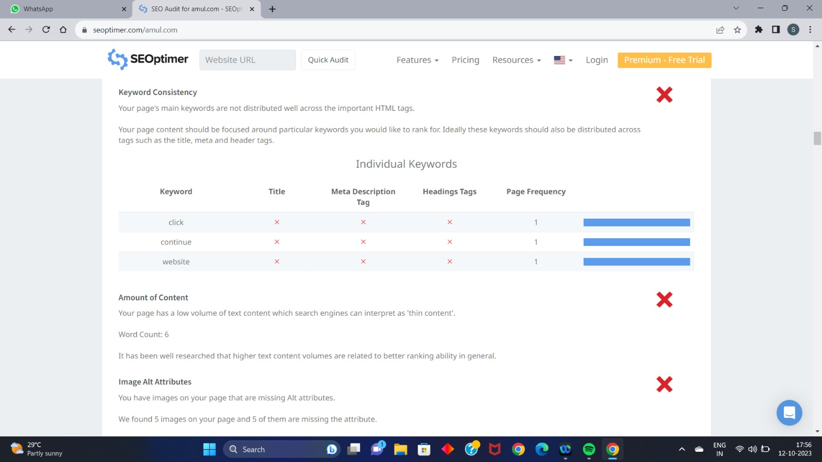
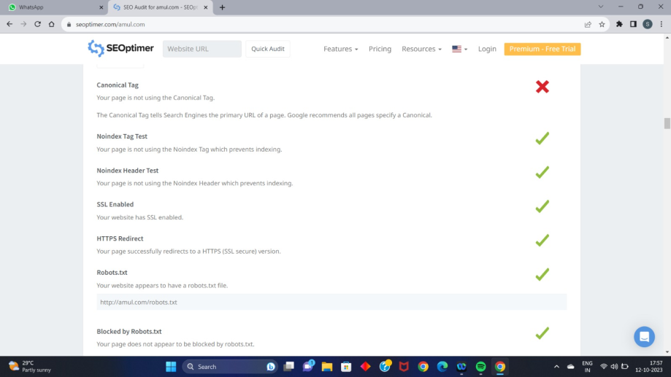

Slide 22
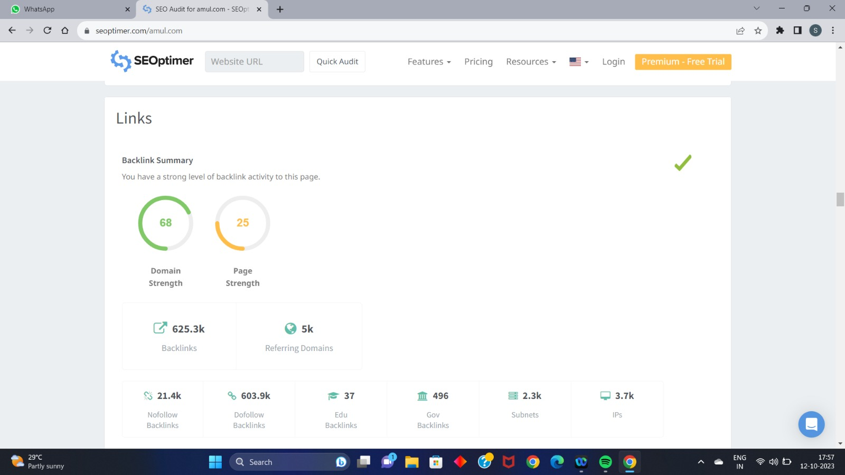
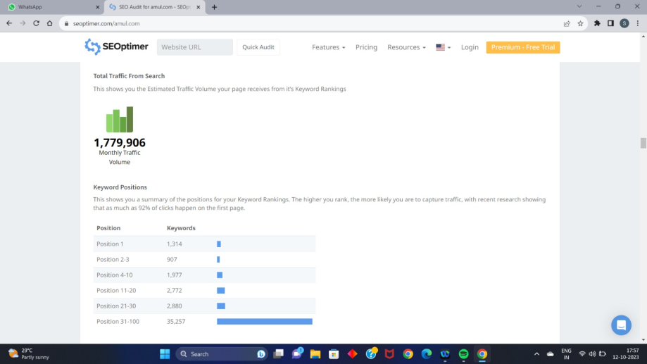

Slide 23
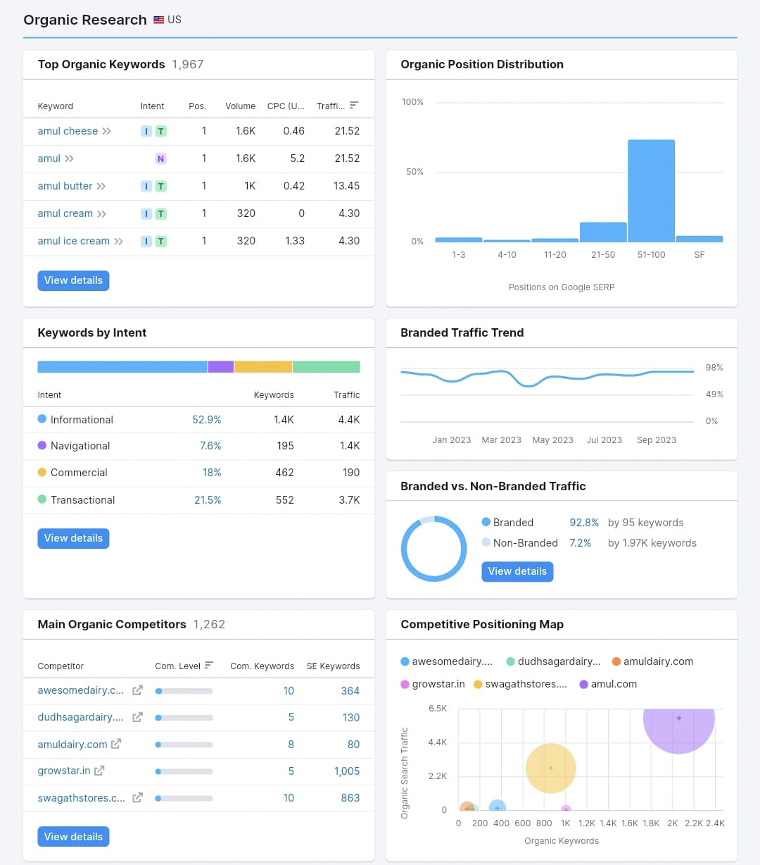
Tracking amul’s keywords ,realise that there are organic keywords that bring you to amul’s website ,which are amul cheese, amul , amul butter , amul cream, amul ice cream.

Slide 24
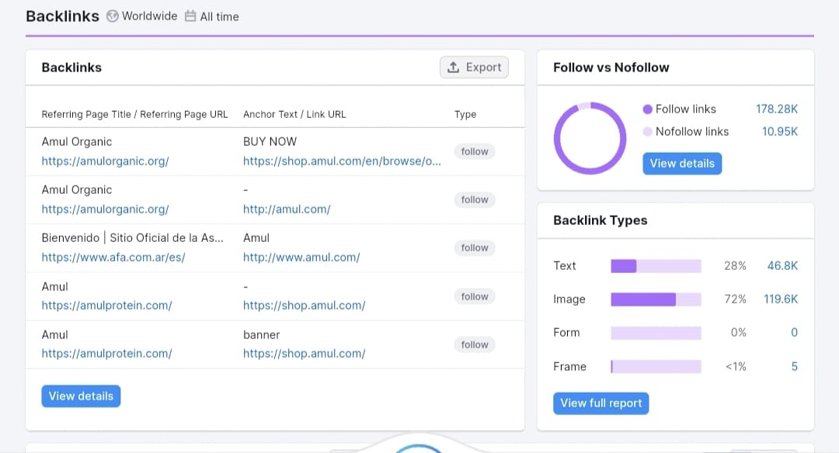
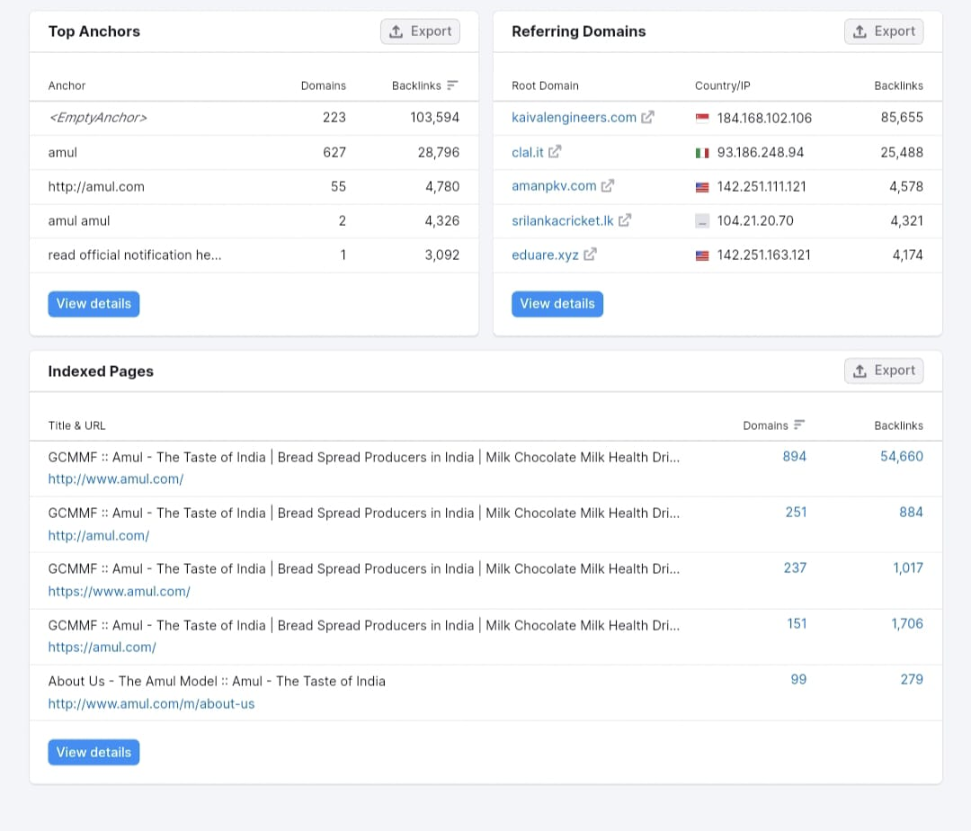

Slide 25
KEYWORD ANALYSIS:
RESEARCH OBJECTIVES:
Research objectives are the specific goals or questions that a research project aims to address or answer. They guide the design and execution of the research, and help to evaluate its outcomes and implications.
To analyze the customer perception and satisfaction regarding Amul products and services, and the factors influencing their choice and loyalty.
To evaluate the effectiveness of the marketing strategy and sales promotion of Amul in different market segments and regions, and to explore new opportunities for expansion and diversification.

Slide 26

KEYWORDS FOR AMUL

Slide 27
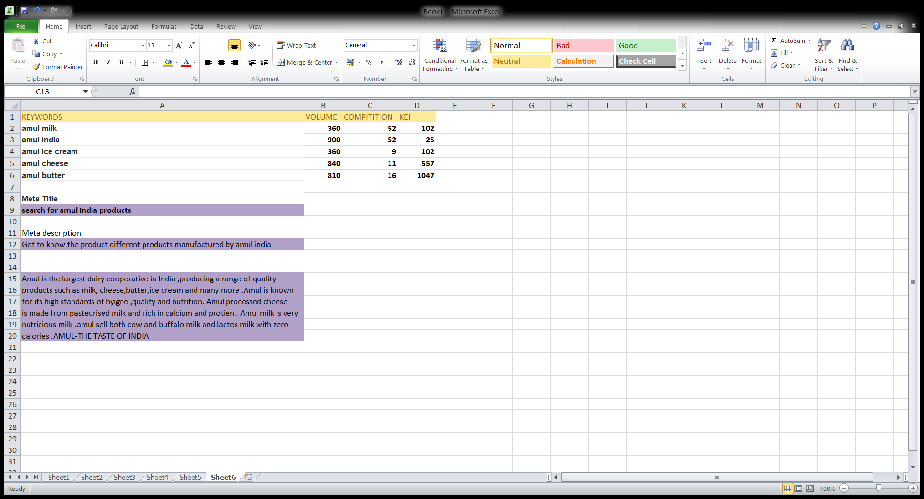
META TAG OPTAMIZATION

Slide 28
PART 3:- CONTENT IDEA &MARKET STRATEGIES

Slide 29

CONTENT CALENDER

Slide 30
MARKET STRAGIES OF AMUL & CHALLENGES FACED BY AMUL :-
Amul has a strong presence on social media platforms such as Instagram, Facebook, Twitter, and YouTube, where it posts creative and topical content related to its products, brand values, and current affairs. Amul uses its iconic mascot, the Amul girl, to create witty and humorous posts that capture the attention of the audience and generate high engagement.
Some of the challenges faced by Amul in social media marketing are :
Keeping up with the changing trends and preferences of the audience .
Maintaining a consistent tone and voice across different platforms .
Dealing with negative feedback and complaints from customers .
Measuring the return on investment (ROI) and impact of social media campaigns

Slide 31
PART 4:- CONTENT CREATION AND CURATION

Slide 32
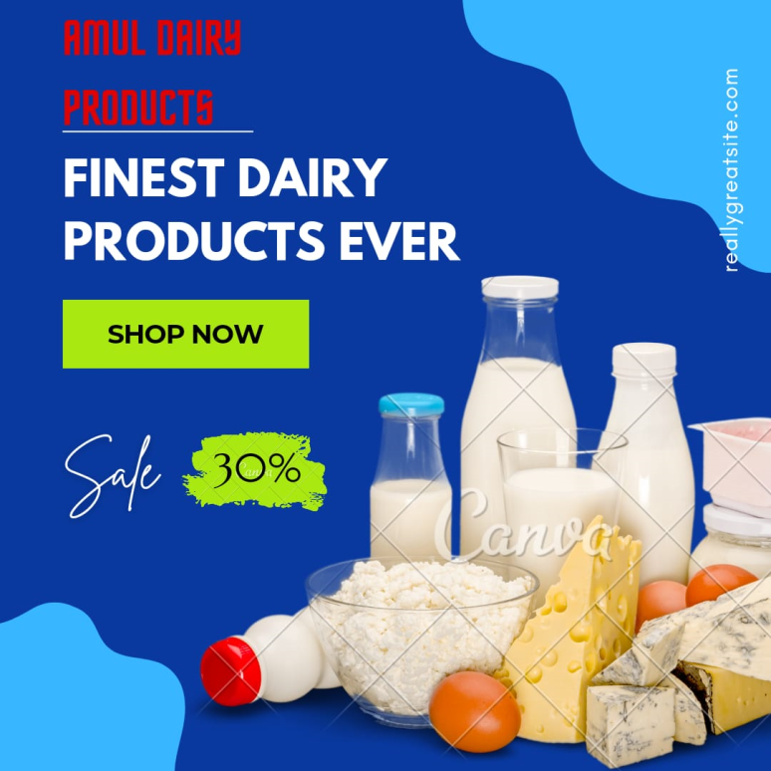
POST CREATION :-
FORMAT 1:- INFOGRAPHICS.
I create a infographic templet for promoting amul dairy products . Its shows the dairy products and offer for those products and it has CTA (call –to –action ) showing shop now .

Slide 33

FORMAT 2:- VIDEO
The video content is to promote amul sponsership .
Amul sponser the south african cricket team .amul promotes their brand buy saying that the team wins because of drinking amul milk.

Slide 34
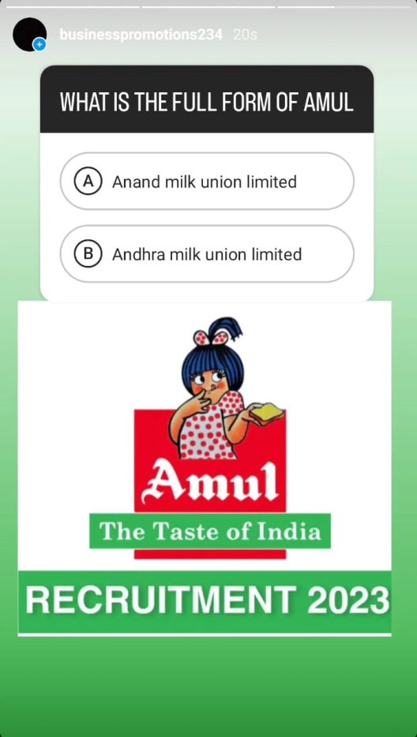
FORMAT 3:- QUIZ
I create a quiz in instagram about amul India products and online activities using instagram tools .

Slide 35
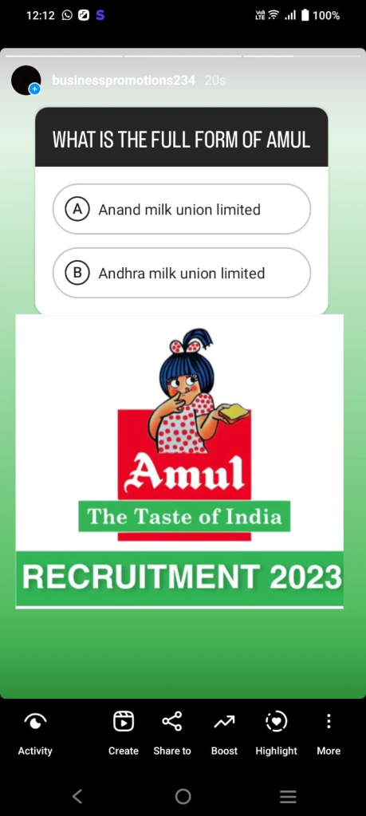
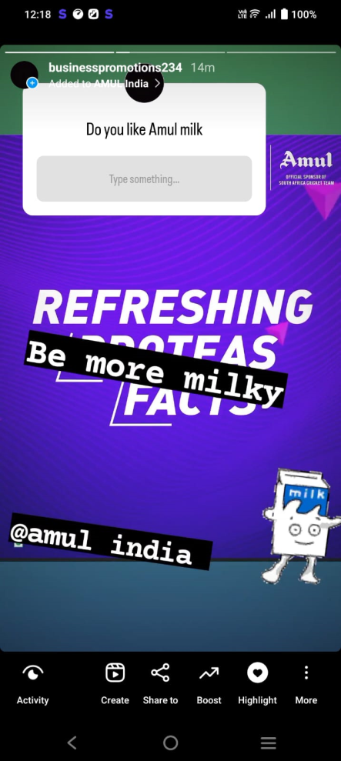
INSTAGRAM STORY
https://instagram.com/businesspromotions234?igshid=YTQwZjQ0NmI0OA==
Url for instagram account
Highlights name :- AMUL India

Slide 36
THANK YOU FOR THIS OPPORTUNITY.

